Slide 1
Natural Language Processing
CSCI 5832—Lecture 5
Jim Martin

Slide 2
Today
More on HMMs
3 HMM problems and algorithms
Decoding (Viterbi)
Forward
EM, (Forward-Backward or Baum-Welch)

Slide 3
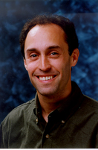
HMMs for Ice Cream
You are a climatologist in the year 2799 studying global warming
You can’t find any records of the weather in Baltimore for summer of 2007
But you find Jason Eisner’s diary which lists how many ice creams Jason ate every day that summer
Your job: figure out how hot it was each day

Slide 4
Eisner Task
Given
An ice cream observation sequence 1,2,3,2,2,2,3…
Produce
Hidden weather sequence
H,C,H,H,H,C, C…

Slide 5
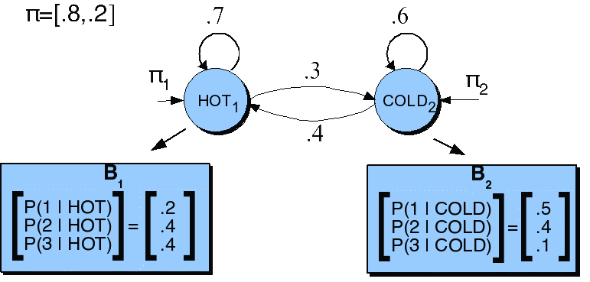
HMM for Ice Cream

Slide 6
Ice Cream HMM
Let’s just do “1,3,1” as a sample sequence
How many underlying state (hot/cold) sequences are there for this sequence?
How do you pick the right one?
HHH
HHC
HCH
HCC
CCC
CCH
CHC
CHH
Argmax P(sequence | 1 3 1)

Slide 7
Ice Cream HMM
Let’s just do 1 sequence: CHC
Cold as the initial state
P(Cold|Start)
.2
.5
.4
.4
.3
.5
Observing a 1 on a cold day
P(1 | Cold)
Hot as the next state
P(Hot | Cold)
Observing a 3 on a hot day
P(3 | Hot)
.0024
Cold as the next state
P(Cold|Hot)
Observing a 1 on a cold day
P(1 | Cold)

Slide 8
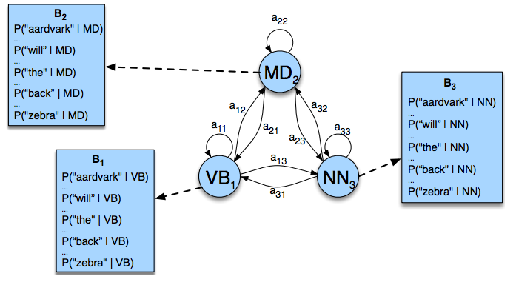
POS Tagging as an HMM

Slide 9
Question
If there are 30 or so tags in the Penn set
And the average sentence is around 20 words...
How many tag sequences do we have to enumerate to argmax over in the worst case scenario?
30²⁰

Slide 10
Hidden Markov Models
States Q = q₁, q₂…q_{N;}
Observations O= o₁, o₂…o_{N;}
Each observation is a symbol from a vocabulary V = {v₁,v₂,…v_{V}}
Transition probabilities
Transition probability matrix A = {a_{ij}}
Observation likelihoods
Output probability matrix B={b_{i}(k)}
Special initial probability vector π

Slide 11
3 Problems
Given this framework there are 3 problems that we can pose to an HMM
Given an observation sequence and a model, what is the probability of that sequence?
Given an observation sequence and a model, what is the most likely state sequence?
Given an observation sequence, find the best model parameters

Slide 12
Problem 1
The probability of a sequence given a model...
Used in sequence classification tasks
Word spotting in ASR, language identification, speaker identification, author identification, etc.
Train one model per class
Given an observation, pass it to each model and compute P(seq|model)
Argmax over models gives you the class
Used in model development... How do I know if some change I made to the model is making things better?

Slide 13
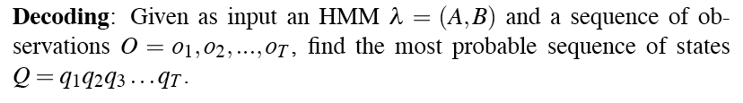
Problem 2
Most probable state sequence given a model and an observation sequence
Typically used in sequence labeling problems, where the labels correspond to hidden states
As we’ll see almost any problem can be cast as a sequence labeling problem

Slide 14
Problem 3
Infer the best model parameters, given a model and an observation sequence...
That is, fill in the A and B tables with the right numbers...
The numbers that make the observation sequence most likely
Useful for getting an HMM without having to hire annotators…

Slide 15
Solutions
Problem 2: Viterbi
Problem 1: Forward
Problem 3: Forward-Backward
An instance of Expectation Maximization (EM)

Slide 16
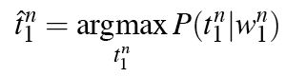
Problem 2: Decoding
Assume we have a complete model that can give us what we need. Recall that we need to get
We could just enumerate all paths (as we did with the ice cream example) given the input and use the model to assign probabilities to each.
Not a good idea

Slide 17
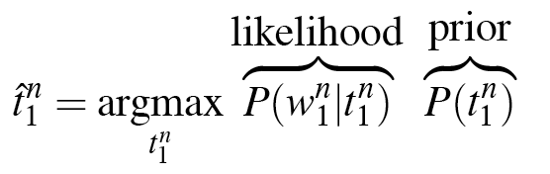
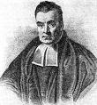
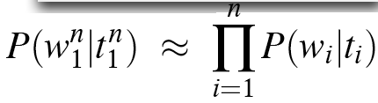
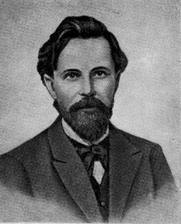
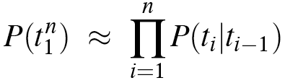
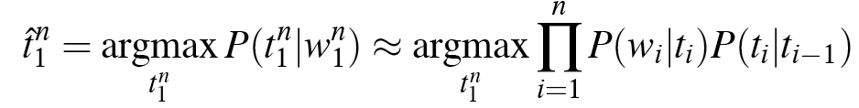
Likelihood and Prior

Slide 18
Intuition
Consider a state/obs sequence that ends at some state at time i (i.e., has a particular tag T at position i in the sequence)
The probability of that tag sequence can be broken into parts
The probability of the sequence up through time i-1
Multiplied by
the transition probability from the tag at the end of the i-1 sequence to T.
And the observation probability of the observed word given tag T

Slide 19
Intuition
We don’t need to know the probability of all the possible paths (tag sequences) that could have led to the current state.
Just the best path that ends with that tag
If that’s true at time i, then its also true at time i-1, and all the way back to the start of time.

Slide 20
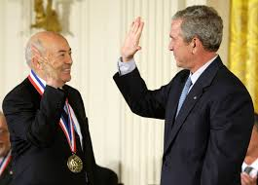
Viterbi
Create an table where
Columns correspond to observations
Rows correspond to possible hidden states
Sweep through the table in one pass filling the columns left to right using given transition probabilities and observations probabilities
Key to using dynamic programming is that we need only store the MAX prob and path to each cell, (not all paths)

Slide 21
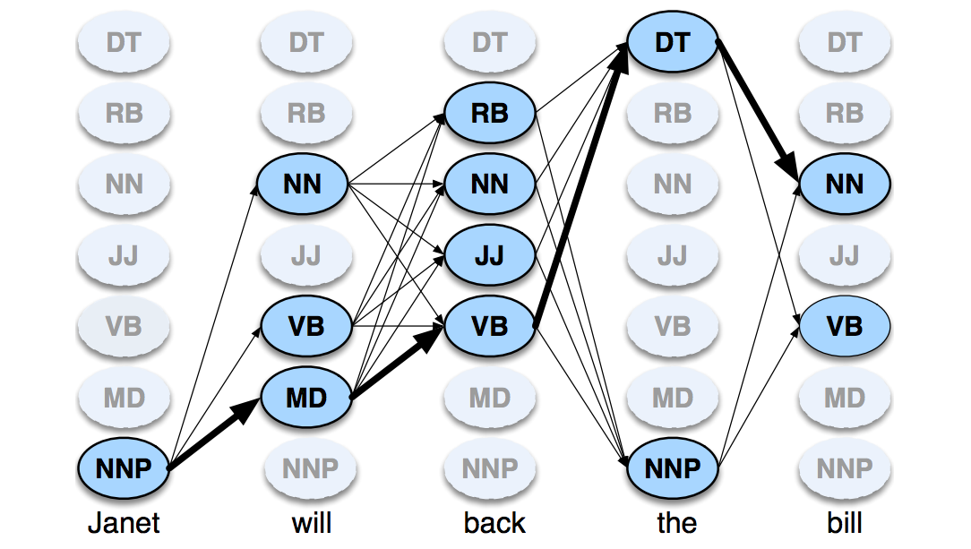
Viterbi Example

Slide 22
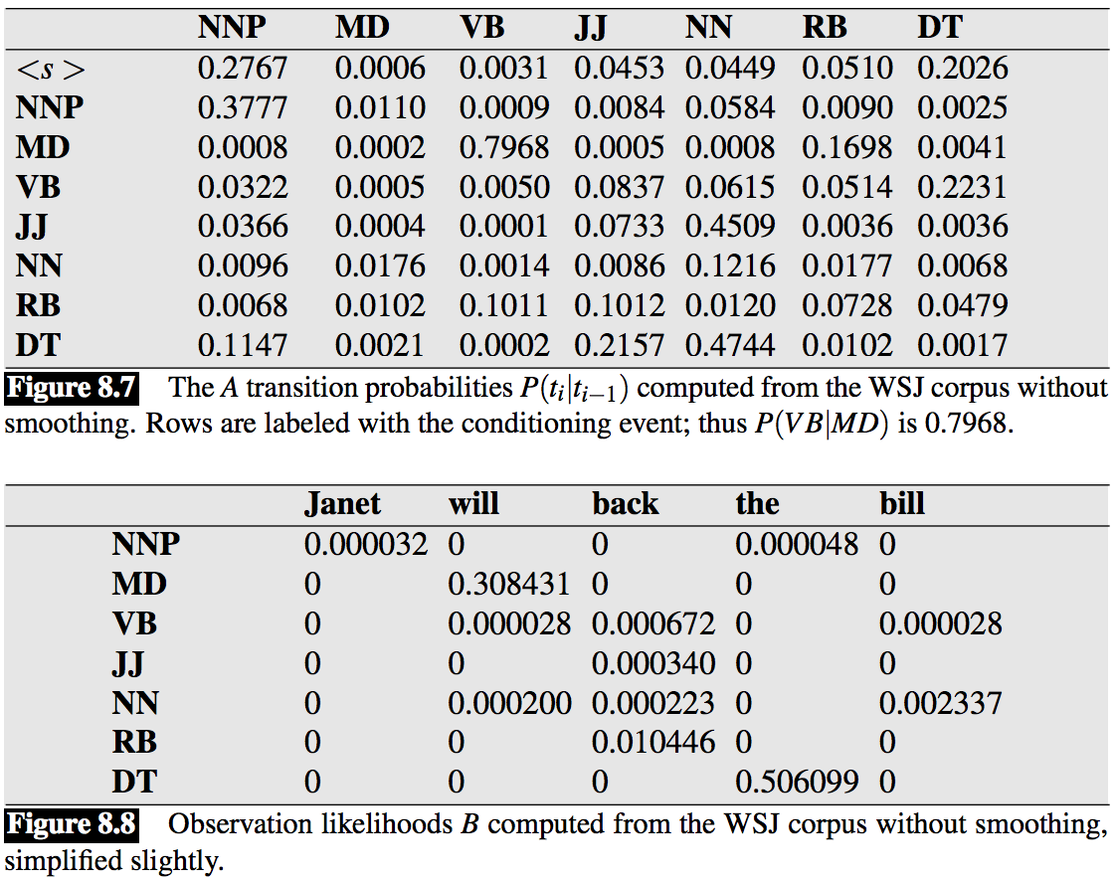
Probabilities

Slide 23
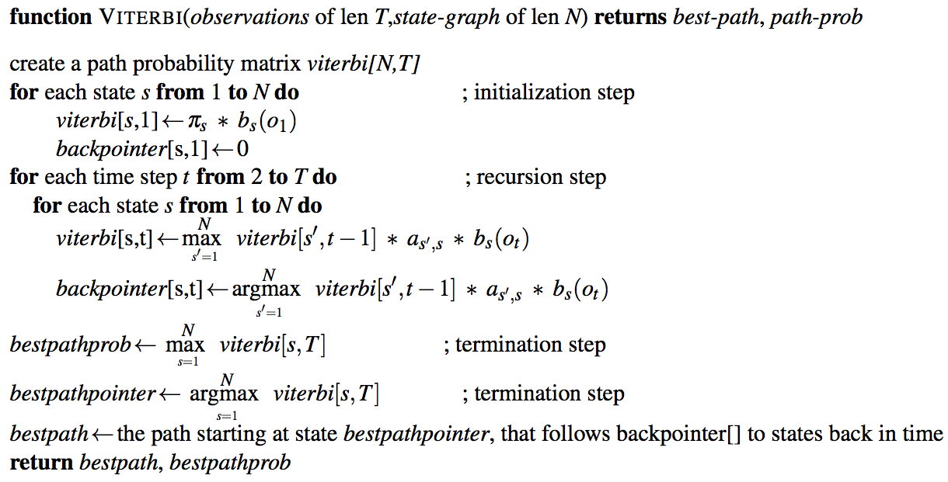
The Viterbi Algorithm

Slide 24
Viterbi Example

Slide 25
Assignment 2
Build an HMM-based POS tagger
POS-tagged data
Bigram model
Viterbi decoding
<UNK> for unknown words
Add-1 smoothing

Slide 26
Office Hours Today
I’ll be leaving at 4:15 today

Slide 27
Problem 1
The probability of a sequence given a model...
Used in sequence classification tasks
Word spotting in ASR, language identification, speaker identification, author identification, etc.
Train one model per class
Given an observation, pass it to each model and compute P(seq|model)
Argmax over models gives you the class
Used in model development... How do I know if some change I made to the model is making things better?

Slide 28
Problem 1: Forward
Given an observation sequence return the probability of the sequence given the model...
In an HMM, any number of sequences might be responsible for a given observation sequence (with some associated probability)
So we need to sum the probabilities of all the paths consistent with some observation sequence

Slide 29
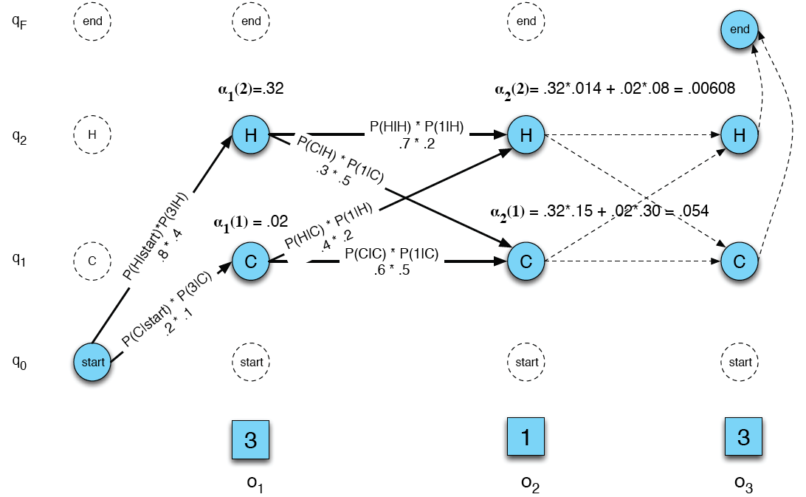
Ice Cream Example

Slide 30
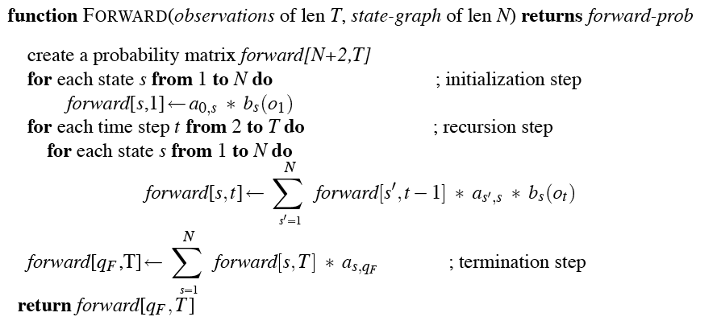
Forward

Slide 31
Text Classification Preview

Slide 32
Is This Spam?

Slide 33
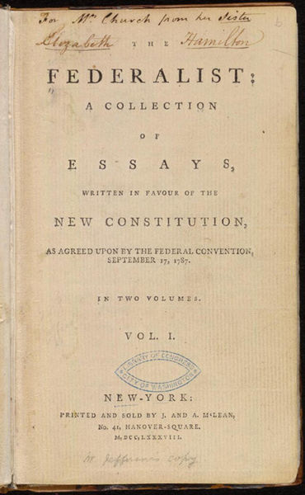
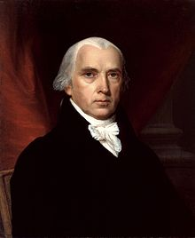
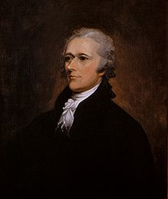
Who Wrote Which Federalist Paper?
1787-8: anonymous essays try to convince New York to ratify new U.S. Constitution: Jay, Madison, Hamilton.
Authorship of 12 of the letters in dispute
1963: solved by Mosteller and Wallace using Bayesian methods
James Madison
Alexander Hamilton

Slide 34



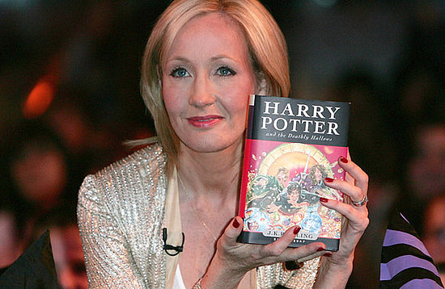
More Recently
The Cuckoo's Calling by Robert Galbraith

Slide 35




Even More Recently
NY Times “Anonymous” editorial

Slide 36
Problem 3: Learning the Model Parameters
An example to get the intuition down
Forward backward

Slide 37
Urn Example
A genie has two urns filled with red and blue balls. The genie selects an urn and then draws a ball from it (and replaces it). The genie then selects either the same urn or the other one and then selects another ball…
The urns are hidden
The balls are observed

Slide 38
Urn
Based on the results of a long series of draws...
Figure out the distribution of colors of balls in each urn
Observation probabilities (B table)
Figure out the genie’s preferences in going from one urn to the next
Transition probabilities (A table)

Slide 39
Urns and Balls
Pi: Urn 1: 0.9; Urn 2: 0.1
A
B
 | Urn 1 | Urn 2
Urn 1 | 0.6 | 0.4
Urn 2 | 0.3 | 0.7
 | Urn 1 | Urn 2
Red | 0.7 | 0.4
Blue | 0.3 | 0.6

Slide 40
Urns and Balls
Assume the input (observables) is Blue Blue Red (BBR)
Since both urns contain
red and blue balls
any path of length 3 through this machine can produce this output
.6
.7
.4
Urn 1
Urn 2
.3

Slide 41
Urns and Balls
Blue Blue Red
1 1 1 | (0.9*0.3)*(0.6*0.3)*(0.6*0.7)=0.0204
1 1 2 | (0.9*0.3)*(0.6*0.3)*(0.4*0.4)=0.0077
1 2 1 | (0.9*0.3)*(0.4*0.6)*(0.3*0.7)=0.0136
1 2 2 | (0.9*0.3)*(0.4*0.6)*(0.7*0.4)=0.0181
2 1 1 | (0.1*0.6)*(0.3*0.7)*(0.6*0.7)=0.0052
2 1 2 | (0.1*0.6)*(0.3*0.7)*(0.4*0.4)=0.0020
2 2 1 | (0.1*0.6)*(0.7*0.6)*(0.3*0.7)=0.0052
2 2 2 | (0.1*0.6)*(0.7*0.6)*(0.7*0.4)=0.0070

Slide 42
Urns and Balls
Viterbi: Says 111 is the most likely state sequence
1 1 1 | (0.9*0.3)*(0.6*0.3)*(0.6*0.7)=0.0204
1 1 2 | (0.9*0.3)*(0.6*0.3)*(0.4*0.4)=0.0077
1 2 1 | (0.9*0.3)*(0.4*0.6)*(0.3*0.7)=0.0136
1 2 2 | (0.9*0.3)*(0.4*0.6)*(0.7*0.4)=0.0181
2 1 1 | (0.1*0.6)*(0.3*0.7)*(0.6*0.7)=0.0052
2 1 2 | (0.1*0.6)*(0.3*0.7)*(0.4*0.4)=0.0020
2 2 1 | (0.1*0.6)*(0.7*0.6)*(0.3*0.7)=0.0052
2 2 2 | (0.1*0.6)*(0.7*0.6)*(0.7*0.4)=0.0070

Slide 43
Urns and Balls
Forward: P(BBR| model) = .0792
∑
1 1 1 | (0.9*0.3)*(0.6*0.3)*(0.6*0.7)=0.0204
1 1 2 | (0.9*0.3)*(0.6*0.3)*(0.4*0.4)=0.0077
1 2 1 | (0.9*0.3)*(0.4*0.6)*(0.3*0.7)=0.0136
1 2 2 | (0.9*0.3)*(0.4*0.6)*(0.7*0.4)=0.0181
2 1 1 | (0.1*0.6)*(0.3*0.7)*(0.6*0.7)=0.0052
2 1 2 | (0.1*0.6)*(0.3*0.7)*(0.4*0.4)=0.0020
2 2 1 | (0.1*0.6)*(0.7*0.6)*(0.3*0.7)=0.0052
2 2 2 | (0.1*0.6)*(0.7*0.6)*(0.7*0.4)=0.0070

Slide 44
Urns and Balls
EM
What if I told you I lied about the numbers in the model (Priors, A, B). That is, I just made them up.
Can I get better numbers just from the input sequence?

Slide 45
Urns and Balls
Yes
Count up and prorate the number of times a given transition is traversed while processing the observations inputs.
Then use that pro-rated count to re-estimate the transition probability for that transition

Slide 46
Urns and Balls
But… we don’t know the actual path the input took, its hidden!
So prorate the counts from all the possible paths based on the path probabilities the model gives you
Basically do what Forward does
But you said the numbers were wrong
Doesn’t matter; use the original numbers then replace the old ones with the new ones. The new ones have to be better than the old ones.

Slide 47
Urn Example
.6
.7
.4
Urn 1
Urn 2
.3
Let’s re-estimate the Urn1->Urn2 transition and the Urn1->Urn1 transition (using Blue Blue Red as training data).

Slide 48
Another View
We can view all those products as a lattice
That is, unroll the state machine in time
Time 1 2 3 4
1
1
1
1
2
2
2
2
Observations Blue Blue Red Blue

Slide 49
Another View
Re-estimating the 1-> 2 transitions...
1
1
1
1
2
2
2
2
Blue Blue Red Blue
Time

Slide 50
Another View
Re-estimating the 1-> 2 transitions...
1
1
1
1
2
2
2
2
Blue Blue Red Blue
Time

Slide 51
Urns and Balls
Blue Blue Red
1 1 1 | (0.9*0.3)*(0.6*0.3)*(0.6*0.7)=0.0204
1 1 2 | (0.9*0.3)*(0.6*0.3)*(0.4*0.4)=0.0077
1 2 1 | (0.9*0.3)*(0.4*0.6)*(0.3*0.7)=0.0136
1 2 2 | (0.9*0.3)*(0.4*0.6)*(0.7*0.4)=0.0181
First, what exactly is this probability?
2 1 1 | (0.1*0.6)*(0.3*0.7)*(0.6*0.7)=0.0052
2 1 2 | (0.1*0.6)*(0.3*0.7)*(0.4*0.4)=0.0020
2 2 1 | (0.1*0.6)*(0.7*0.6)*(0.3*0.7)=0.0052
2 2 2 | (0.1*0.6)*(0.7*0.6)*(0.7*0.4)=0.0070

Slide 52
Urns and Balls
So the probability of passing through 1->2 is the weighted sum of the paths taken through that transition given the observations
(.0077*1)+(.0136*1)+(.0181*1)+(.0020*1)
= .0414
But, that’s not the probability we want, it needs to be divided by the probability of leaving Urn 1 total (normalized).
There’s only one other way out of Urn 1 (going back to urn1)
So let’s reestimate Urn1-> Urn1

Slide 53
Urn Example
.6
.7
.4
Urn 1
Urn 2
.3
Let’s re-estimate the Urn1->Urn1 transition

Slide 54
Urns and Balls
Blue Blue Red
1 1 1 | (0.9*0.3)*(0.6*0.3)*(0.6*0.7)=0.0204
1 1 2 | (0.9*0.3)*(0.6*0.3)*(0.4*0.4)=0.0077
1 2 1 | (0.9*0.3)*(0.4*0.6)*(0.3*0.7)=0.0136
1 2 2 | (0.9*0.3)*(0.4*0.6)*(0.7*0.4)=0.0181
2 1 1 | (0.1*0.6)*(0.3*0.7)*(0.6*0.7)=0.0052
2 1 2 | (0.1*0.6)*(0.3*0.7)*(0.4*0.4)=0.0020
2 2 1 | (0.1*0.6)*(0.7*0.6)*(0.3*0.7)=0.0052
2 2 2 | (0.1*0.6)*(0.7*0.6)*(0.7*0.4)=0.0070

Slide 55
Urns and Balls
That’s
(2*.0204)+(1*.0077)+(1*.0052) = .0537
Again, not what we need but we’re closer… we just need to normalize using those two numbers.

Slide 56
Urns and Balls
The 1->2 transition probability is
.0414/(.0414+.0537) = 0.435
The 1->1 transition probability is
.0537/(.0414+.0537) = 0.565
So in re-estimation the 1->2 transition went up from .4 to .435 and the 1->1 transition went down from .6 to .565

Slide 57
EM Re-Estimation
Not done yet. No reason to think those values are right. They’re just more right than they used to be.
So do it again, and again and....
Until convergence
Convergence does not guarantee a global optima, just a local one
As with Problems 1 and 2, you wouldn’t actually compute it this way. Enumerating all the paths is infeasible.

Slide 58
The Point
Given an untagged corpus and a fixed size tag set
You can automatically learn both the transition probabilities and the observation probabilities needed to create an HMM-based POS tagger.

